Slide 1

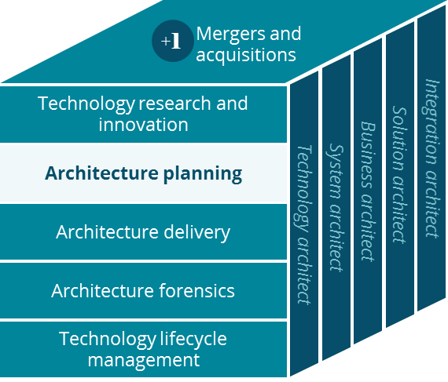
PBM Business Canvas
Architecture Planning
George M. Hillocks
4/2/2019

Slide 2
PBM - Business Canvas
Holistic view of the current PBM business model
Key Partnerships
Key Activities
Value Proposition
Customer Relationships
Customer Segment
Health Plans
Employers
Mail Order Pharmacy
Claim Adjudication
Transform Care
Formulary Management
Face to Face
Clients
Digital
Clients & Patients
Health Plans
Employers
PBMs
Silver Scripts
Insurance Co
Patient Care
Clinical Services
Maintenance Choice
Rebates
Phone
Clients & Patients
Unions
Government Employee Groups
CVS Pharmacy
Retail Pharmacies
Rx Benefit Management
Client & Member Billing
Managed Networks
Brand to Generic Substitutions
Prescription Drug Plans (PDP)
Managed Medicaid
Relay Health
(Network)
Suppliers
Manufacturers
Rebates
Plan Design
Pharmacy Advisor
Infusion Services
Channels
Public Exchanges
Private Exchanges
Prescribers
SureScripts (eRx)
Key Resources
Medical Claims Editing
Mail
E-Mail
Patients
Data Vendors
Prescribers/Drugs
Communication Vendors
Pharmacists & Pharmacy Techs
Sales and Marketing
Phone
Text,
2-way SMS
Shippers
UPS/USPS
Banks
Customer Service Reps
Benefits Administrators
Digital
IVR
Analytics
Nurses
Fax - Prescribers
E-Messaging - Prescribers
Cost Structure
Revenue Streams
Customer Service Reps
Inventory
Client Pay
Co-Pay
PDP Premiums
Pharmacists & Pharmacy Techs
Marketing & Sales
CMS Subsidies for Med-D
Rx Network Admin Fees
Performance Guarantees
Compliance & Regulatory
Includes: PBM, Mail Order, Specialty, Coram, and Novologix

